Slide 1
Effect of Intravascular Ultrasound-Guided vs. Angiography-Guided Everolimus-Eluting Stent Implantation: the IVUS-XPL Randomized Clinical Trial
Embargoed Until 10:45 a.m. ET, Tuesday, Nov. 10, 2015
Myeong-Ki Hong, MD. PhD
on behalf of the IVUS-XPL trial investigators
Severance Cardiovascular Hospital and Cardiovascular Research Institute, Yonsei University College of Medicine, Seoul, Korea

Slide 2
Clinical usefulness of IVUS
Background
IVUS usage during PCI
Improved clinical outcomes
There are no adequately powered randomized clinical trials to prove the clinical usefulness of IVUS for second-generation DESs.
Hypothesis
The clinical outcomes of IVUS-guided second-generation DES implantation would be superior to those of angiography-guided DES implantation in a subset of patients with long coronary lesions.

Slide 3
Study Design
A prospective, randomized, multi-center trial
At 20 centers in Korea
Enrollment period: Oct 2010 and July 2014
Key inclusion criteria
Age 20 years or older
Patients with typical chest pain or evidence of myocardial ischemia
Non-emergent conditions
Stent length ≥ 28 mm based on angiographic estimation
Significant coronary artery stenosis (>50% based on visual estimate) considered for coronary revascularization with stent implantation
Key exclusion criteria
Acute ST-segment elevation or MI within 48 hours
Age >80 years
Cardiogenic shock
Left ventricular ejection fraction <40%
Left main disease requiring PCI
Bifurcation lesion with 2-stent technique
Chronic total occlusion
Presence of previously implanted DES within 6 months
In-stent restenosis lesion

Slide 4
Study Design
Patients with long coronary lesions
(Implanted stent ≥28 mm in length)
N = 1400
DES implantation with
IVUS guidance
n = 700
DES implantation with
angiography guidance
n = 700
Clinical follow-up at 12 months
Primary end point: MACE
Cardiac death, target-lesion related MI, and ischemia-driven TLR
Trial Registration: clinicaltrial.gov Identifier: NCT01308281
Clinicaltrial.gov Identifier: NCT01308281

Slide 5
Statistical Analysis
Sample size calculation
Assumption the overall incidence of MACE to be 7% at the 1-year in the angiography-guidance arm.
Superiority comparison with an expected risk reduction of 50% in the IVUS-guidance arm (α=0.05, β=0.8, drop-out=5-10%)
Each 700 patients in the IVUS guidance arm and in the angiography guidance arm.
Primary analysis
Intention-to-treat analysis with cumulative incidences of MACE at 1 year using the Kaplan-Meier estimates.
Comparison using the log-rank test.
Turco MA, et al. JACC Cardiovasc Interv. 2008;1:699-709
Kim YH, et al. Circulation. 2006;114:2148-2153

Slide 6
Procedure
Criteria for stent optimization
IVUS-guidance arm
Minimal lumen CSA > lumen CSA at distal reference segments
Angiography-guidance arm
Angiographic residual diameter stenosis <30% and the absence of angiographically detected dissection

Slide 7
Study Flow
13372 | Patients underwent coronary angiography during the study inclusion period
11972 Excluded
1400 Randomized
700 | Randomized to undergo IVUS-guidance PCI
700 | Randomized to undergo angiography-guidance PCI
678 22 4 36 | Underwent IVUS-guidance PCI as randomized Underwent angiography-guidance PCI Withdrew consent Lost to follow-up
670 30 3 34 | Underwent angiography-guidance PCI as randomized Underwent IVUS-guidance PCI Withdrew consent Lost to follow-up
5 17 | Technical failure to deliver IVUS catheter Physician decision due to unfavorable coronary anatomy
22 8 | Physician preference in complex lesions Angiographically ambiguous anatomy
700 | Included in primary analysis
700 | Included in primary analysis

Slide 8
Baseline Characteristics
Characteristics | IVUS-guidance | Angiography-guidance | P value
No. of patients | 700 | 700
Age, y | 64 (9) | 64 (9) | .54
Male sex | 483 (69) | 481 (69) | .91
Hypertension | 454 (65) | 444 (63) | .58
Diabetes mellitus | 250 (36) | 256 (37) | .74
Left ventricular ejection fraction, % | 62.9 ± 9.8 | 62.4 ± 10.2 | .33
Clinical presentation |  |  | .36
Stable angina | 358 (51) | 356 (51)
Unstable angina | 242 (35) | 226 (32)
Acute myocardial infarction | 100 (14) | 118 (17)
No. of treated lesions per patients | 1.34 (0.56) | 1.36 (0.57) | .57
Duration of DAPT, days | 365 (180, 365) | 365 (180, 365) | .15
Coronary arteries |  |  | .14
Left anterior descending artery | 455 (65) | 419 (60)
Left circumflex artery | 96 (14) | 108 (15)
Right coronary artery | 149 (21) | 173 (25)
Baseline QCA data
Reference vessel diameter, mm | 2.89 ± 0.45 | 2.85 ± 0.45 | .13
Minimum lumen diameter, mm | 0.83 ± 0.42 | 0.82 ± 0.43 | .56
Diameter stenosis, % | 71.1 ± 14.3 | 71.4 ± 14.4 | .70
Lesion length, mm | 34.7 ± 10.8 | 35.2 ± 10.5 | .41
Stent length, mm | 39.3 ± 13.1 | 39.2 ± 12.3 | .90

Slide 9
Angiographic and Procedural Characteristics
Characteristics | IVUS-guidance | Angiography-guidance | P value
Adjunct post-dilatation | 534 (76) | 402 (57) | <.001
Final balloon size, mm | 3.14 ± 0.43 | 3.04 ± 0.42 | <.001
Overlapping stent | 145 (21) | 138 (20) | .64
No. of stents per lesions | 1.3 (0.5) | 1.3 (0.5) | .48
Stent edge dissections | 15 (2) | 13 (2) | .70
Coronary perforation | 0 | 0 | 1.00
Maximal inflation pressure, atm | 16.5 ± 4.1 | 15.9 ± 4.1 | .052
Post-intervention QCA data
Reference vessel diameter, mm | 3.03 ± 0.44 | 2.97 ± 0.43 | .01
Minimum lumen diameter, mm | 2.64 ± 0.42 | 2.56 ± 0.39 | <.001
Diameter stenosis, % | 12.79 ± 8.66 | 13.74 ± 8.05 | .04

Slide 10
Clinical outcomes at 1 year
 | IVUS- guidance (n=700) | Angiography- guidance (n=700) | Hazard ratio (95% CI) | Log-Rank P value
Primary End Point
MACE | 19 (2.9%) | 39 (5.8%) | 0.48 (0.28–0.83) | .007
Secondary End Point
Cardiac death | 3 (0.4%) | 5 (0.7%) | 0.60 (0.14-2.52) | .48
Target lesion related MI | 0 | 1 (0.1%) | - | .32
Ischemia-driven TLR | 17 (2.5%) | 33 (5.0%) | 0.51 (0.28-0.91) | .02
Stent thrombosis | 2 (0.3%) | 2 (0.3%) | 1.00 (0.14-7.10) | 1.00
Acute | 1 (0.1%) | 1 (0.1%) | - | -
Sub-acute | 1 (0.1%) | 0 | - | -
Late | 0 | 1 (0.1%) | - | -

Slide 11
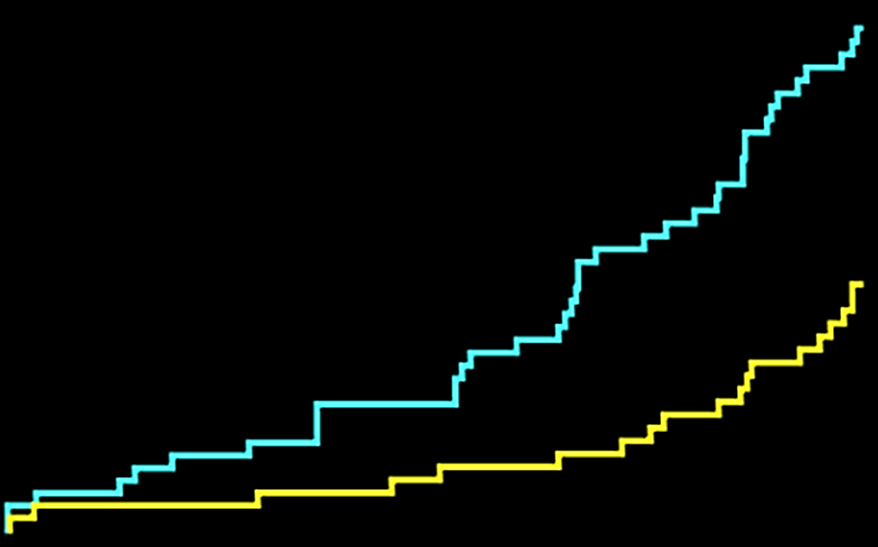
Primary End Point
6
5.8%
HR, 0.48 (95% CI, 0.28-0.83)
Log-rank P = .007
4
Angiography-guidance
Patients with Primary
End Point Event, %
2.9%
2
IVUS-guidance
0
0
3
6
9
12
Time Since Randomization, mo
No. at risk
Angiography arm
IVUS arm
700
700
673
671
660
665
643
654
624
641

Slide 12
Post-intervention IVUS analysis in subgroup of IVUS guidance
Procedural and IVUS Characteristics | Patients meeting the IVUS criteria | Patients not meeting the IVUS criteria | P value
No. of patients | 363 | 315
Adjunct post-dilatation | 282 (78) | 237 (75) | .34
Final balloon size, mm | 3.15 ± 0.45) | 3.13 ± 0.42 | .52
Maximal inflation pressure, atm | 16.5 ± 3.9 | 16.4 ± 4.4 | .87
Proximal reference EEM area, mm² | 17.52 ± 5.34 | 17.27 ± 5.04 | .56
Proximal reference lumen area, mm² | 9.02 ± 3.51 | 8.86 ± 3.27 | .57
Minimal lumen area, mm² | 6.09 ± 1.91 | 5.71 ± 1.71 | .008
Distal reference EEM area, mm² | 9.44 ± 3.98 | 10.94 ± 3.83 | <.001
Distal reference lumen area, mm² | 5.55 ± 1.82 | 6.83 ± 1.68 | <.001

Slide 13
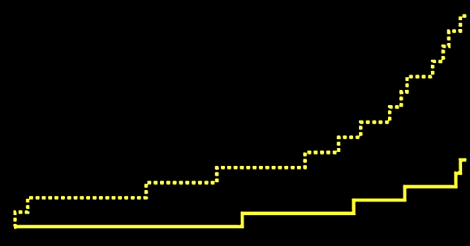
Primary End Point
6
HR, 0.31 (95% CI, 0.11-0.86)
Log-rank P = .017
4.6%
Patients not meeting the IVUS-criteria
for stent optimization
4
Patients with Primary
End Point Event, %
Patients meeting the IVUS-criteria
for stent optimization
2
1.5%
0
0
3
6
9
12
Time Since Randomization, mo
No. at risk
Not meeting the criteria
Meeting the criteria
315
363
299
362
297
345
394
338
285
334

Slide 14
Conclusions
Among patients requiring long coronary stent implantation, the use of IVUS-guidance for DES implantation was associated with a significant 2.9% absolute reduction and 48% relative reduction in the risk of MACE at 1 year, compared with angiography-guidance.
Our findings suggest better clinical outcomes of MACE with IVUS-guidance compared to angiography-guidance for DES implantation, particularly for diffuse long lesions.

Slide 15
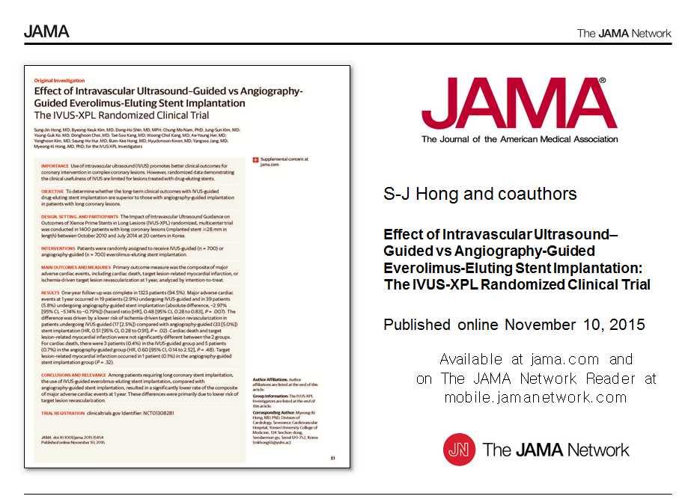
Dreams will
come true

